Slide 1

Digital Portfolio
STUDENT NAME: R Charulatha
REGISTER NO AND NMID: 222402526-asunm161222402526
DEPARTMENT: ll-cs
COLLEGE:Prince shri venkesteshwara art and science college/madras university
1
Notes:
1

Slide 2

PROJECT TITLE
Digital portfolio
2

Slide 3



AGENDA
Problem Statement
Project Overview
End Users
Tools and Technologies
Portfolio design and Layout
Features and Functionality
Results and Screenshots
Conclusion
Github Link
3/21/2024 Annual Review
3

Slide 4

Ah, you want a problem statement (project description) for the portfolio website code 🚀
Here’s a clear Problem Statement for this project:
---
📌 Problem Statement
Students often face difficulties in showcasing their skills, projects, and contact details in a structured and professional manner. Traditional resumes are static and cannot fully reflect their abilities or projects. There is a need for a personal portfolio website that:
1. Displays the student’s profile information (name, photo, short bio).
2. Highlights skills in a clean and organized way.
3. Presents projects with descriptions for better visibility.
4. Provides contact details (such as LinkedIn profile) for networking opportunities.
5. Is easy to customize and responsive so any student can adapt it to their needs.
---
✅ This Student Portfolio Website solves the problem by creating a simple, responsive, and well-structured webpage where students can present themselves effectively to recruiters, teachers, and peers.
---
Would you like me to also write a Project Objective & Outcome section along with the problem statement (like how NPTEL assignments/projects usually need)?
PROBLEM STATEMENT
4

Slide 5

Here’s a simple Project Overview in 4 lines:
---
📌 Project Overview
This project is a student portfolio website designed to showcase personal details, skills, and projects.
It includes sections like About, Skills, Projects, and Contact for better presentation.
The website helps students highlight their abilities in a professional and structured format.
It is easy to customize and responsive, making it suitable for academic or career purposes.
---
Do you also want me to prepare a short abstract (2–3 lines) that you can use in reports or submissions?
PROJECT OVERVIEW
5

Slide 6

WHO ARE THE END USERS?
In your student portfolio website, the end users are the people who will visit and interact with your portfolio.
That usually includes:
1. Recruiters / Hiring Managers – who check your skills, projects, and contact info to evaluate you for jobs or internships.
2. Teachers / Professors – if you are showcasing your academic work or projects.
3. Peers / Classmates – who might refer you to opportunities or collaborate on projects.
4. Clients – if you plan to use your portfolio to get freelance or project-based work.
5. You (the Owner) – you are also an end user, since you’ll update, maintain, and share the portfolio.
👉 In simple words: any person who views your portfolio website to know about you, your skills, and your projects is the end user.
Do you want me to explain this as a short answer for your project report (2–3 lines), or as detailed explanation?
6

Slide 7

TOOLS AND TECHNIQUES
Tools
1.HTML code
2.CSS
3.web browser
7

Slide 8
Here’s a clear explanation of the Portfolio Design and Layout for your project:
---
📌 Portfolio Design and Layout
1. Sidebar (Left Panel) – Contains the student’s photo, name, description, and navigation menu.
2. Main Content (Right Panel) – Divided into four sections: About, Skills, Projects, and Contact.
3. Skills Section – Displays skill cards in a neat layout for quick readability.
4. Projects Section – Uses a grid design to highlight each project with title and description.
5. Contact Section – Provides LinkedIn link for professional networking.
6. Overall Layout – Clean, simple, and responsive design for easy customization.
---
👉 Would you like me to also make a diagram (layout sketch) of this portfolio design so you can visualize it better?
POTFOLIO DESIGN AND LAYOUT
8

Slide 9
Here’s a clear explanation of the Features and Functionality of your portfolio project:
---
📌 Features and Functionality
1. Profile Section – Displays student’s photo, name, and short introduction.
2. Navigation Menu – Sidebar links allow smooth movement to different sections (About, Skills, Projects, Contact).
3. About Section – Provides a personal introduction and academic/career interests.
4. Skills Section – Showcases programming skills in a card layout for quick visibility.
5. Projects Section – Highlights completed projects with titles and descriptions.
6. Contact Section – Shares LinkedIn profile link for professional communication.
7. Responsive Design – Works well on both desktop and mobile devices.
8. Easy Customization – Student can update photo, skills, projects, and links anytime.
---
Do you also want me to write Advantages of this Portfolio Website (like points you can use in a report or viva)?
FEATURES AND FUNCTIONALITY

Slide 10
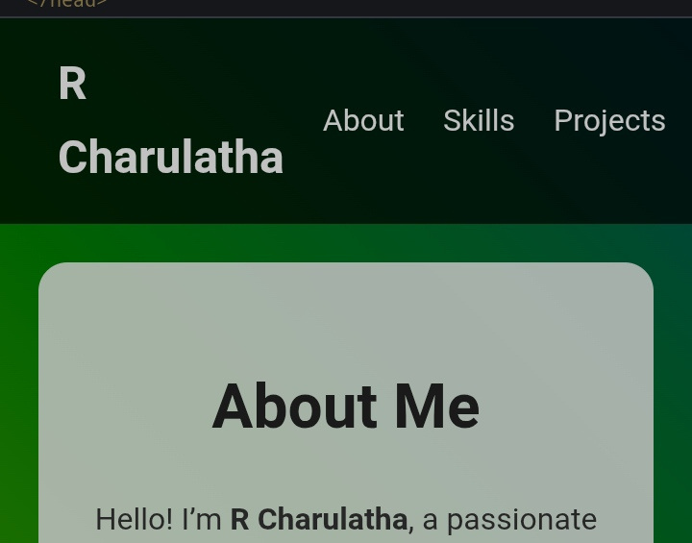

RESULTS AND SCREENSHOTS
3/21/2024 Annual Review
10

Slide 11
CONCLUSION
Here’s a short and simple conclusion you can add to your report 👇
Conclusion:
This portfolio highlights the student’s skills, projects, and contact details in a clear and professional way. It serves as a useful platform for recruiters, teachers, and peers to know more about the student.
---
👉 Do you want me to put together the entire report (Problem Statement, Overview, End Users, Tools & Techniques, Design & Layout, Conclusion) in one neat format for you?
11

Slide 12
Github link
https://r-charulatha13512cs.github.io/TNSCD-FWD-DP15/

